Slide 1
ROLES OF A LEADER

Slide 2
MINTZBERG ROLES OF A LEADER
FIGUREHEAD :
-Entertaining clients and customers as an official representative of the organisation.
- Making oneself available to outsiders as a representative of the organisation.
- Serving an official representative at gatherings outside organisation.
- Escorting official visitors

Slide 3
2. SPOKESPERSON
When a manager acts as a spokesperson, the emphasis is on answering inquiries and formally reporting to individuals and groups outside the managers direct organisational unit. He needs to inform the five people about units Plans, Capabilities, Possibilities:
Upper level management
Clients or customers
Other important outsiders
Professional colleagues
General public

Slide 4
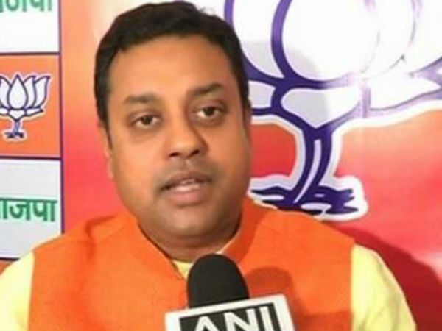
SAMBIT PATRA

Slide 5
NEGOTIATOR
TRYING TO MAKE DEALS WITH OTHERS FOR RESOURSES NEEDED. LIKE-
Bargaining with superiors for funds, facilities, equipment or forms of support
Bargaining with other units in the organisation for the use of staff, facilities, equipment
Bargaining with suppliers and vendors for services, schedules and delivery times.

Slide 6
COACH AND MOTIVATOR
ROLES INCLUDE
Informally recognising the team members’ achievements.
Give feedback concerning ineffective performance
Ensure team members are informed of steps to be followed to improve their performance
Implement rewards and punishments to encourage and sustain good performance

Slide 7
TEAM BUILDER
A KEY ROLE OF A LEADER IS TO BUILD EFFECTIVE TEAM.
Ensure team members are recognized for their accomplishments such as, through letter of appreciation
Initiating activities that contribute to group morale, such as giving parties and sponsoring sports teams.
Holding periodic staff meeting to encourage team members to talk about their accomplishments, problems, and concerns.

Slide 8
TEAM PLAYER
THREE BEHAVIOURS OF TEAM PLAYERS ARE:
Displaying appropriate personal conduct
cooperate with other units
display loyalty to superiors by supporting their plans and decisions fully.

Slide 9
TECHNICAL PROBLEM SOLVER
PARTICULARLY FOR SUPERVISORS AND MIDDLE MANAGERS
Serving as a technical expert a technical expert or advisor
Perform individual contribution tasks like making sales call and repairing machinery.

Slide 10
ENTREPRENEUR
NOT SELF EMPLOYED BUT MANAGER HAVE SOME RESPONSIBILTY FOR SUGGESTING INNOVATIVE IDEAS. THREE ENTREPRENURIAL LEADERSHIP ROLE ATIVITIES ARE:
Read trade publications, professional journals to track what is happening in the industry.
Talk to customers or others in the organisation to keep aware of changing needs and requirements.
Getting involved in situations outside the unit that could suggest ways to improve the unit’s performance .

Slide 11
STRATEGIC PLANNER
TOP MANAGERS ENGANGE IN STRATEGIC PLANNING , USUALLY ASSISTED BY INPUT FROM OTHERS THROUGHOUT THE ORGANISATION. SPECIFIC ACTIVITIES ARE:
Setting a vision and direction for the organization.
Helping the Firm deal with the external environment
Helping develop organisational policies.

Slide 12

CROSS CULTURAL
Relating to different cultures or comparison between them.

Slide 13
Benefits:
Diverse cultural perspectives can inspire creativity and drive innovation
Local market knowledge and insight makes a business more competitive and profitable
Drawing from a culturally diverse talent pool allows an organization to attract and retain the best talent
A diverse skills base allows an organization to offer a broader and more adaptable range of products and services
Diverse teams are more productive and perform better
Greater opportunity for personal and professional growth

Slide 14
Challenges:
Colleagues from some cultures may be less likely to let their voices be heard
Integration across multicultural teams can be difficult in the face of prejudice or negative cultural stereotypes
Professional communication can be misinterpreted or difficult to understand across languages and cultures
Navigating visa requirements, employment laws, and the cost of accommodating workplace requirements can be difficult
Different understandings of professional etiquette
Conflicting working styles across teams

Slide 15

WORK LIFE CONFLICT

Slide 16
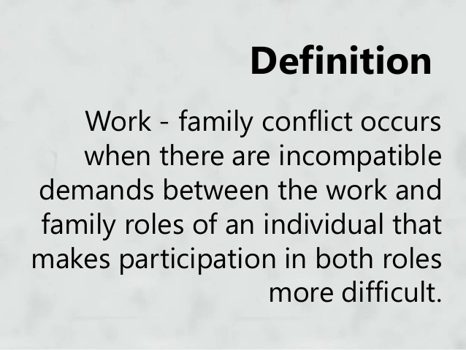

Slide 17
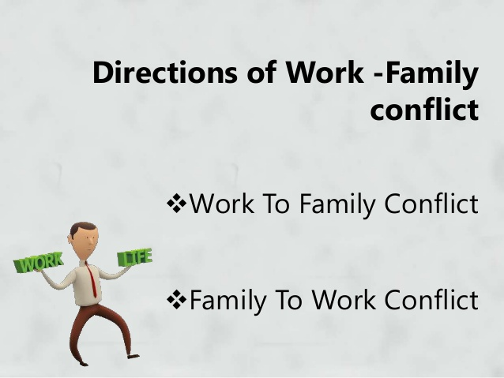

Slide 18
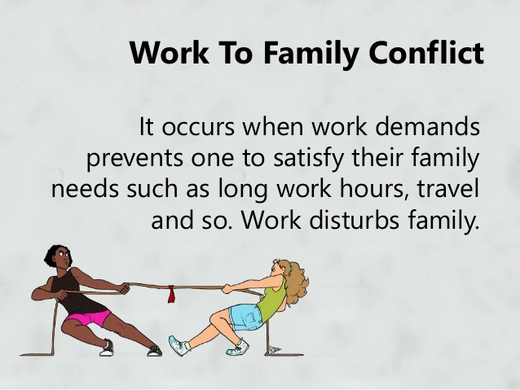

Slide 19
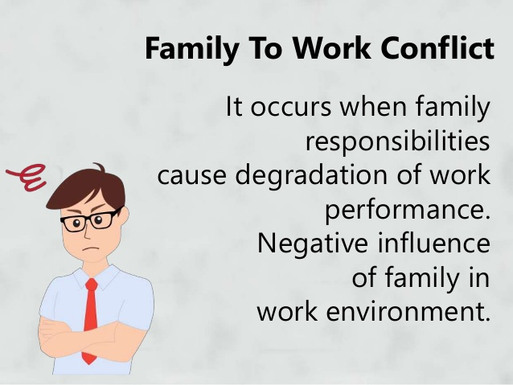

Slide 20
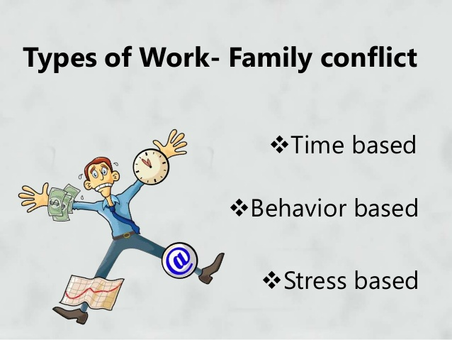

Slide 21
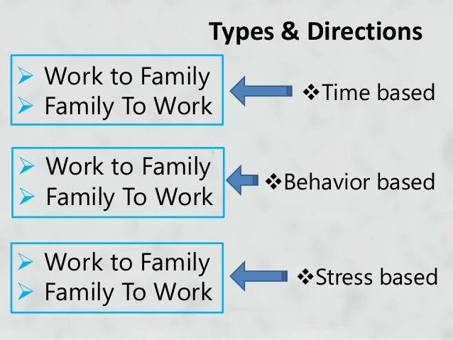

Slide 22
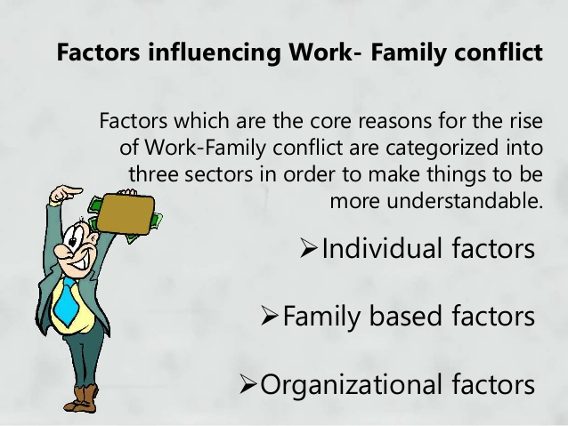

Slide 23
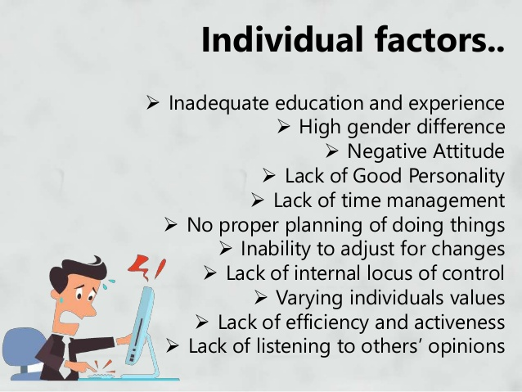

Slide 24
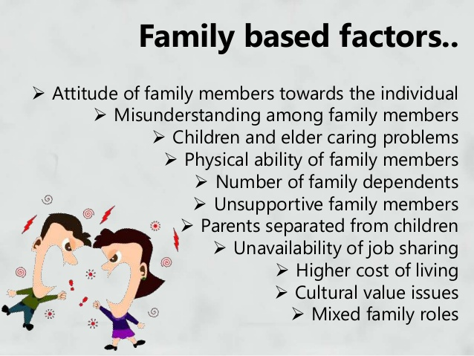

Slide 25
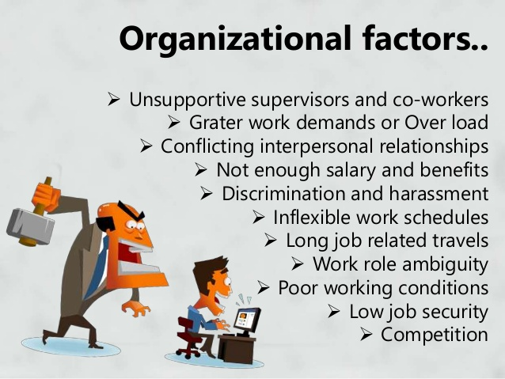

Slide 26
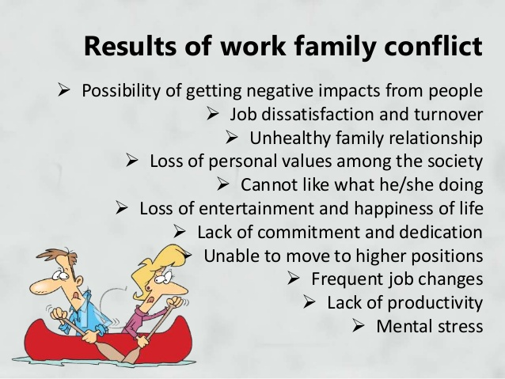

Slide 27


